Slide 1

Introduction to EndNote 25
Chandler Smith, MA (he/him)
Education Librarian & allied health professions liaison

Slide 2
Objectives
Where to find the EndNote 25 download/install
Live demo covering basic features and new features in EndNote 25
How to import citations from different databases
Using the EndNote 25 add-in for Microsoft Word/Google Docs

Slide 3
EndNote 25
What is it?
Software that allows you to organize your research, import references from databases, build a bibliography quickly, and share references with others
Databases have files (typically a .RIS file) you can import into your citation manager
https://libguides.lsuhsc.edu/citationmanagers

Slide 4
Other Citation Managers
Other popular citation management software:
RefWorks (to be rebranded as EndNote Fusion on October 6, 2026) – the Libraries also offer this citation manager!
Zotero

Slide 5
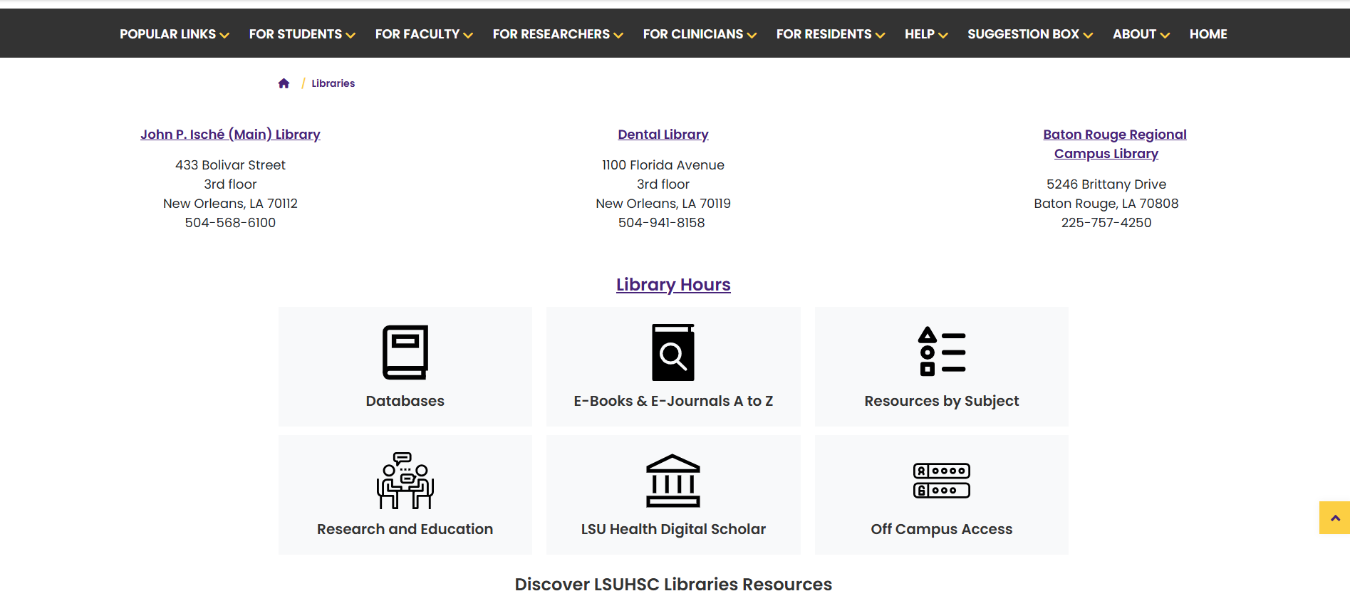

Accessing EndNote 25
Access via Library’s website
Can be found multiple places on our website

Slide 6
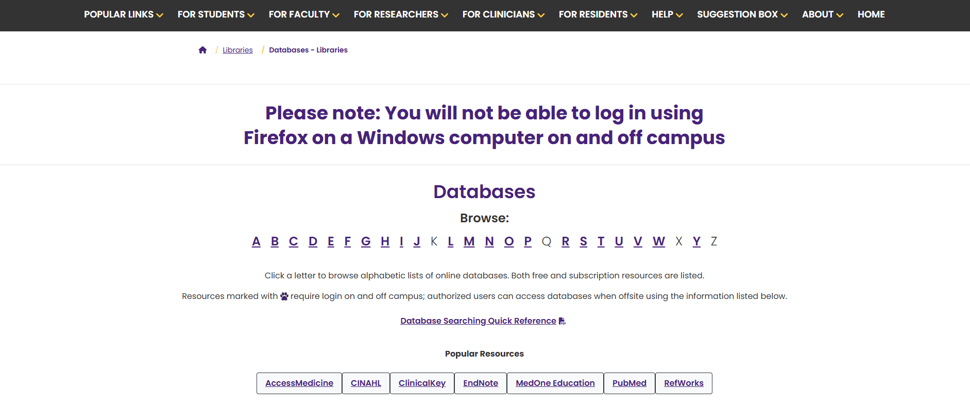
How to Access EndNote 25
Available under “popular resources” or under “E” in the A-Z list

Slide 7
New Features in EndNote 25
Find a journal feature - other resources for this are JANE (Journal/Author Name Estimator) and Cabells (reports for reputable journals/predatory publisher alerts)
AI powered summaries of papers
Summary panel redesign

Slide 8
Live Demo
Showing how to import references from various databases
Find duplicates
Create groups (aka folders) and add collaborators
Demonstrate the new find a journal and summarize paper features
Demonstrate Microsoft Word/Google Docs Add-In

Slide 9
Importing Citations
PubMed
Web of Science
Embase

Slide 10

Questions?

Slide 11
Contact info
Library Contact info:
Email: reference@lsuhsc.edu
Phone: 504-568-6100
Chandler Smith, Ma
Education Librarian
Allied Health Professions Liaison
csmi65@lsuhsc.edu

