Slide 1

Meet the New CINAHL & EBSCO Databases Search Page:
Here’s what's changed…this year!
Sharon Duffy
Research Services Librarian
sduffy@lsuhsc.edu
Rowan Marye
Public Services Librarian
rmarye@lsuhsc.edu

Slide 2
Outline
EBSCOhost User Interface
  What is it? What’s changed?
  Basic Search page
  MyEBSCO account
  New Filter list
  New Pagination
Advanced Search in CINAHL
  Search Filters
  Search Modes
  Accessing CINAHL Subject Headings
  Combining search terms
  Managing search results
  Exporting a full search set
  Questions and contact information

Slide 3
What is the EBSCOhost User Interface?
EBSCOhost is the platform used to access databases such as CINAHL, SocIndex, APA PsycInfo, Academic Search Complete, e-books hosted by EBSCO, and other EBSCO content.
Updates to the interface include:
  Left-hand navigation menu moved to the top
  Dashboard tools moved to MyEBSCO menu
  New filter panel on left-hand side of results page
  Pagination at bottom of results pages
  Link to Library Databases page to access platform: https://www.lsuhsc.edu/library/databases/ebsco.aspx

Slide 4
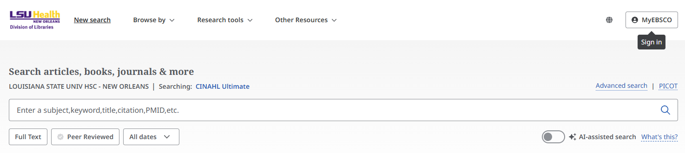
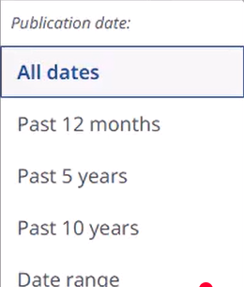
New Basic Search Page
Navigation panel on top
Quick filters to apply before search
Quick filters on home search page:
Full Text – only retrieve articles with full text available
Peer Reviewed – only retrieve results that are marked as peer reviewed articles
All dates – Limit by a time range of publication dates

Slide 5
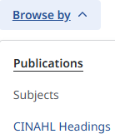
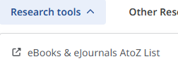
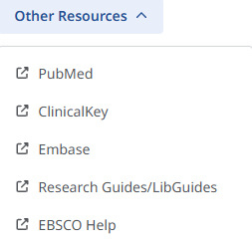

New Navigation Panel
Return to Basic search page to begin a new search
Opens a lower screen on page to:
Browse publications in database by title
Search subject headings of database
Search for CINAHL subject headings (if in CINAHL)
Launches a new screen to search the LSUHSC-NO Libraries E-Journals & E-Books A to Z List
Launches a new screen to the specified database page, Resource Guide page, or EBSCO Help page

Slide 6
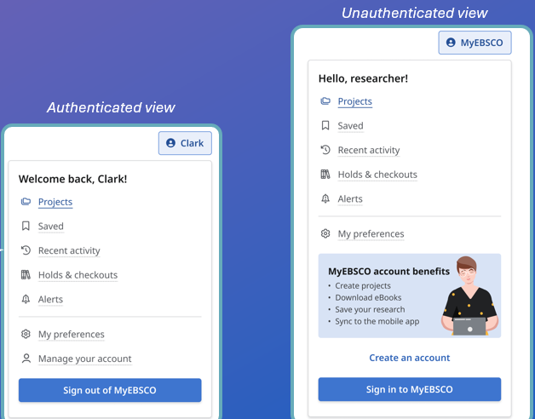
MyEBSCO Account
Free personal account
Same as previous EBSCO account if you had one
Needed to save articles and searches to Projects folder, email results, or export to citation manager

Slide 7
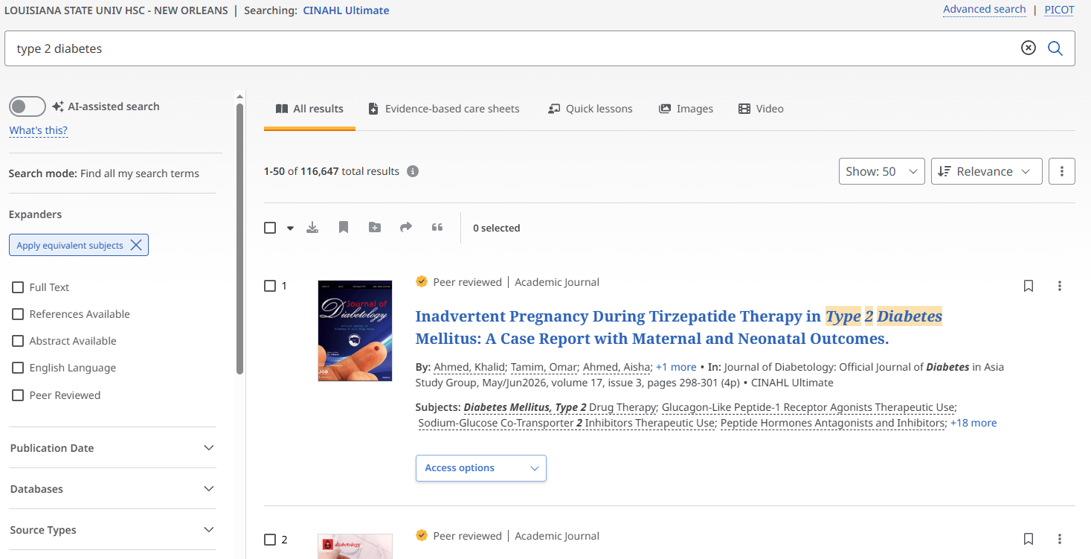
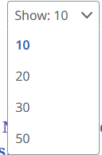
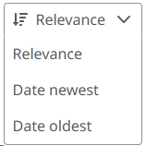
Basic Search Results Page
New expanded filter panel on left side
Display up to 50 results per page
Sort by date or relevance
Click the Access options menu to get PDF or view article online
Now connected with LibKey Nomad

Slide 8
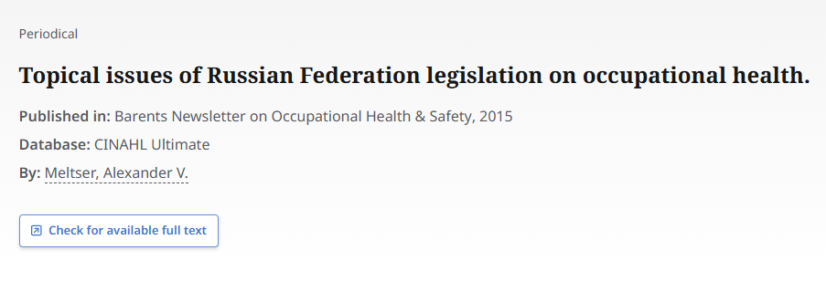
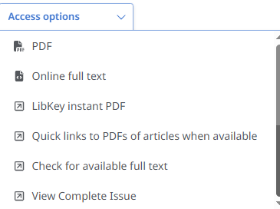
Additional Access options
Options:
PDF – downloadable PDF
Online full text – HTML
LibKey instant PDF – Download PDF
Quick links to PDFs and Check for available full text – LibKey resolver page/choose PDF or link to publisher page
View Complete Issue - Browzine
If we don’t have access to full text, you will see this box, which takes you to page to request article using Interlibrary Loan service.
Get LibKey Nomad here!

Slide 9
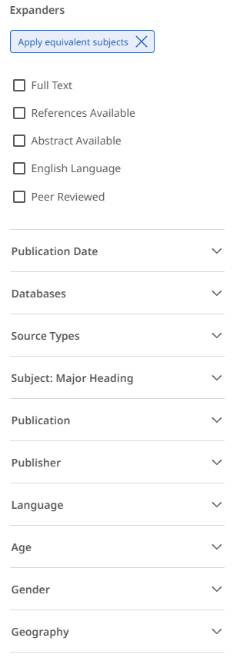
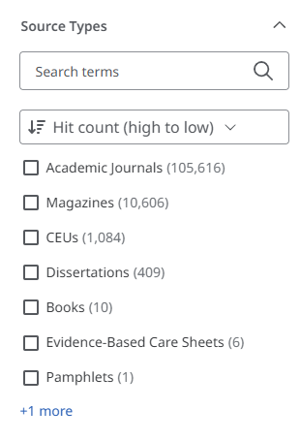
Full Filter List
Quick filters available at top for English language, peer reviewed literature, and more
Click to expand category and view the number of results in the set in each group

Slide 10
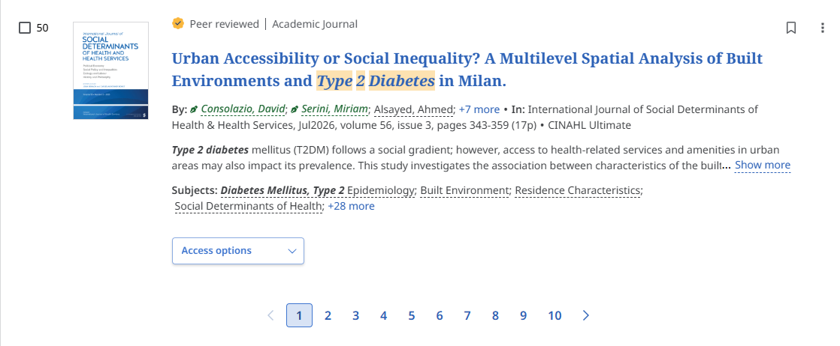
Results Page Pagination
Paginated results allow you to quickly jump in results list

Slide 11
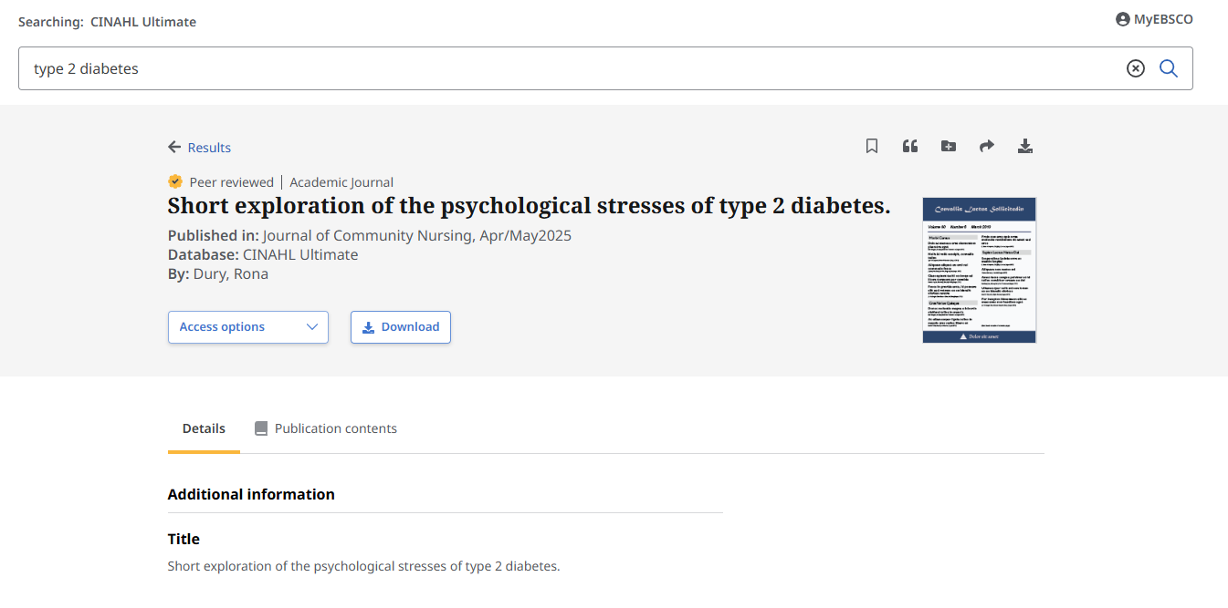
Detailed Record Page Unchanged
Use Tools at top of record to:
  Save article
  Get citation and export
  Add to Project
  Share with a link or via email
  Download the article

Slide 12
Questions?

Slide 13
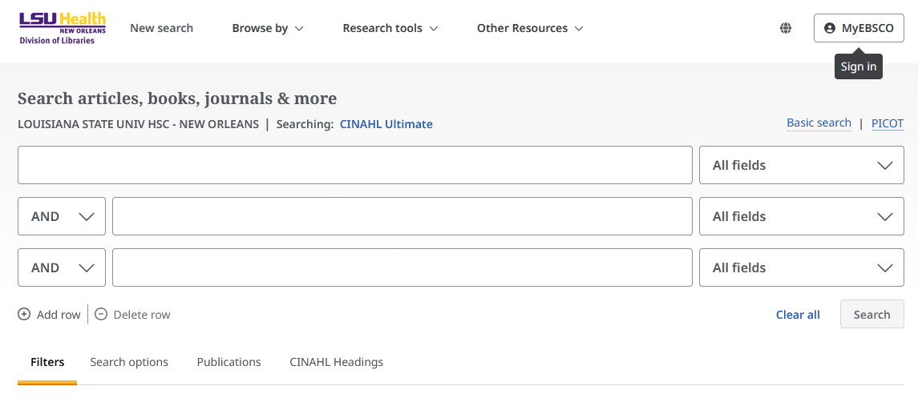
Advanced Searching in CINAHL
Using search options and filters
Search History
Combining terms with Boolean Operators
Exporting results

Slide 14
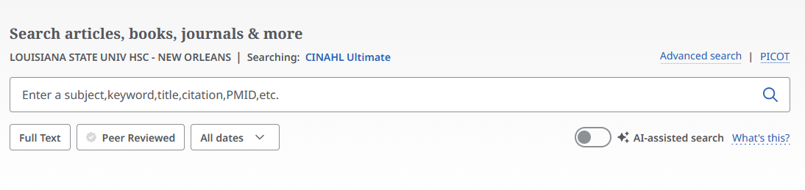
Advanced Search
To change databases, click on the current database about the search bar, then select the desired database from the full EBSCO list.
To access Advanced Search options, click here.

Slide 15
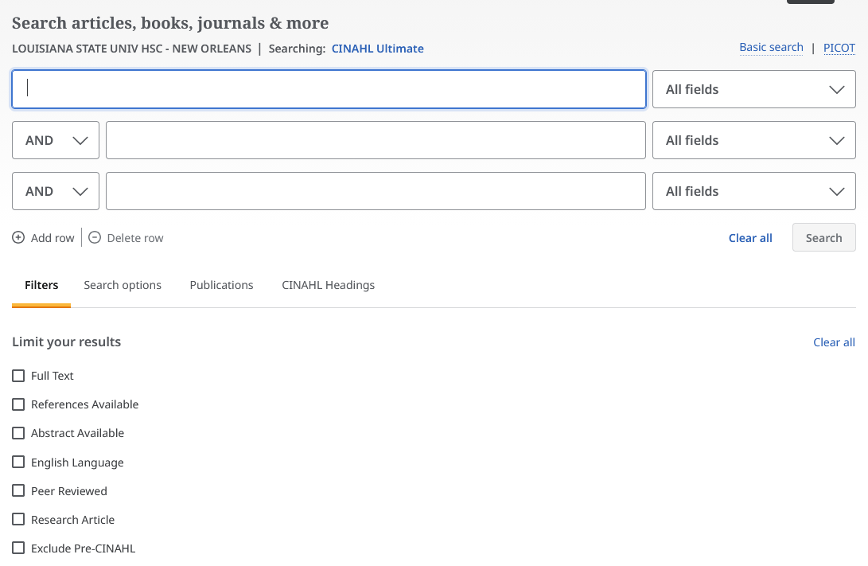
Search Filters and Options
Use these tabs to navigate between filters, search options, publications, and CINAHL Subject headings.
Scroll down for additional limits and options.

Slide 16
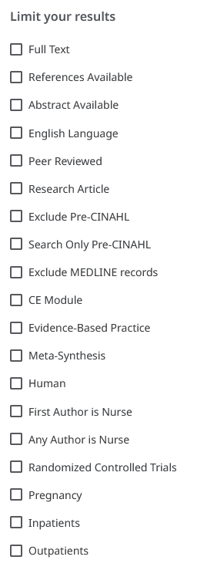
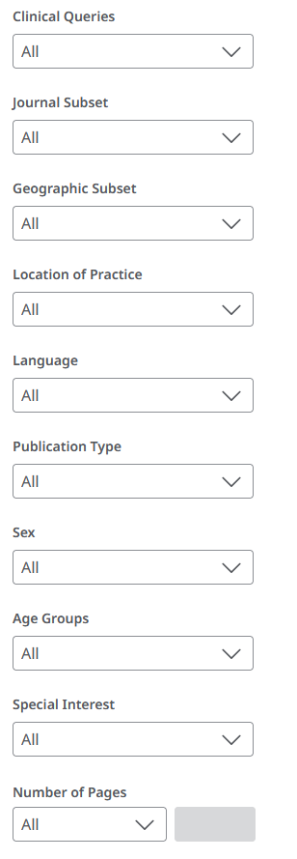
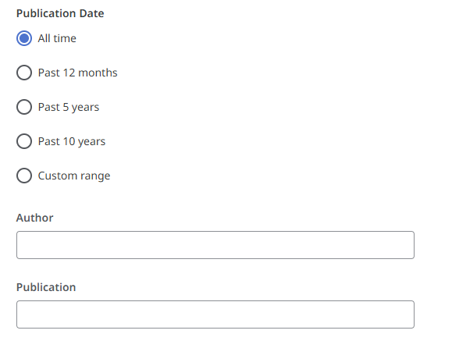
Search Filters

Slide 17
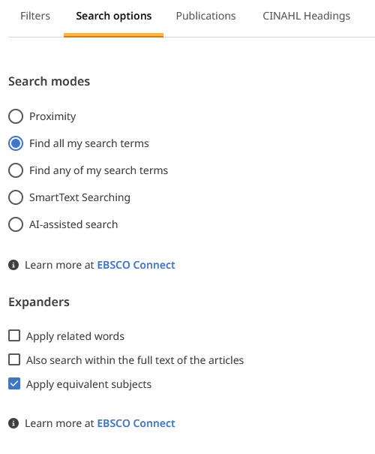
Search Options
Search Modes:
Proximity
  Searches for terms in near proximity to each other. The default is within 3 words of each other.
Find all of my search terms
    Automatically searches with the Boolean “AND” between any entered terms. This is the default mode.
Find any of my search terms
    Automatically searches with the Boolean “OR” between any entered terms.
SmartText Searching
  Permits searching based on a large sample of text.
AI-assisted Search
    NEW: Allows queries using everyday language using Natural Language Processing.
Expanders
These settings broaden the scope of a search by included related keywords or searching the full text of an article.
Note: Boolean Operators, Proximity Indicators, and Field Tags can be manually added for more complex searching.

Slide 18
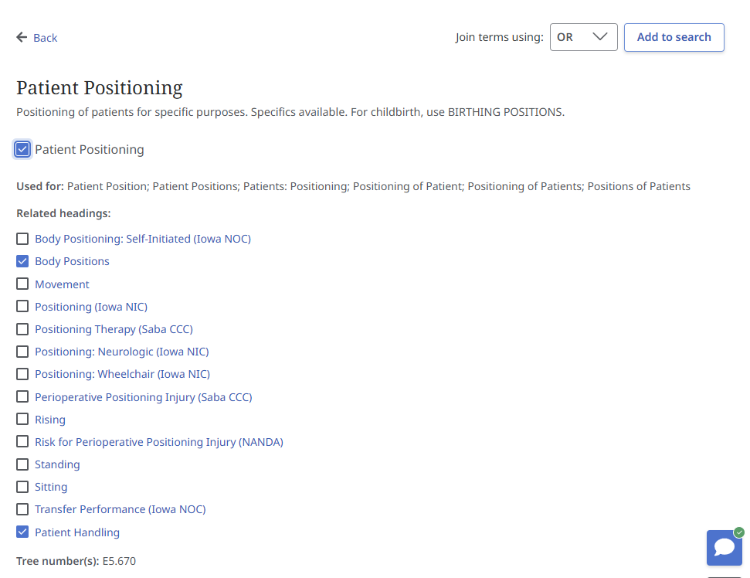
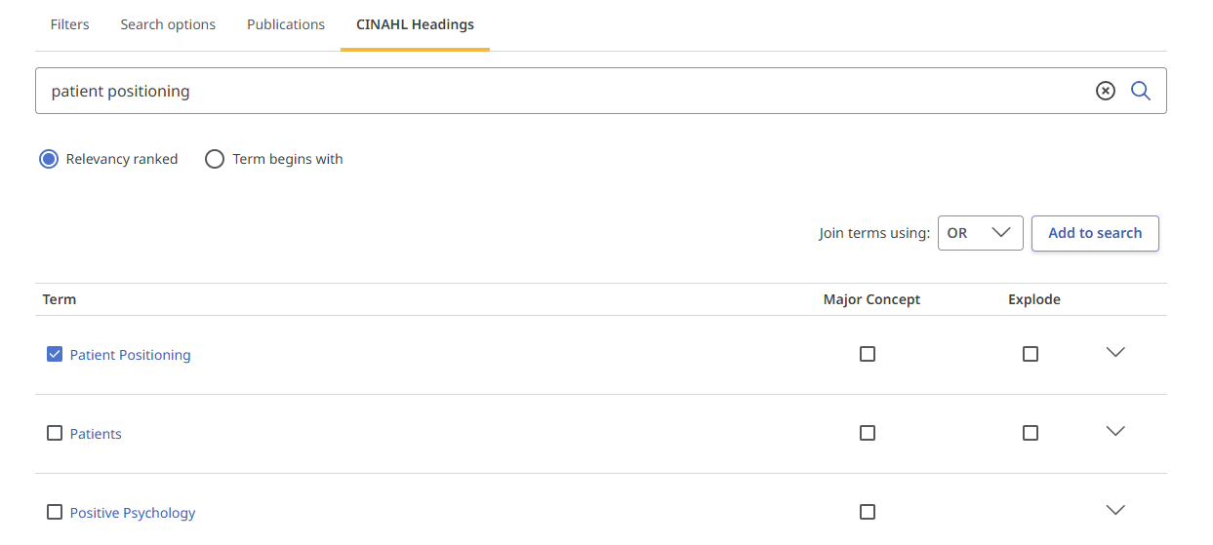
Browsing CINAHL Subject Headings
CINAHL Subject Headings are the list of official terms used by the database to describe topics. They are assigned by the database based on article content. Selecting a term from the results will display an overview and a list of related headings.

Slide 19
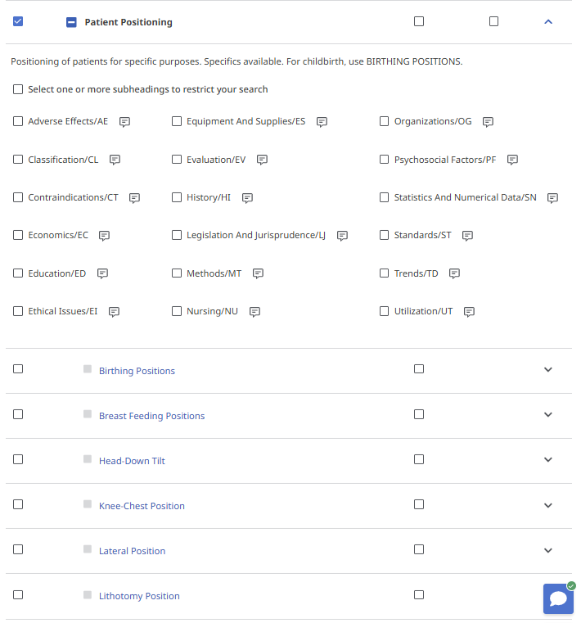
Using CINAHL Subject Headings
Scroll down to see the term in the full CINAHL subject “tree.”
Clicking the checkbox beside an entry will display a brief descriptions and a list subheadings that can be searched in conjunction with your term.
You can click the arrow at the right of the row to hide or display this list.
Click the + to see all narrower terms indexed beneath your term.

Slide 20
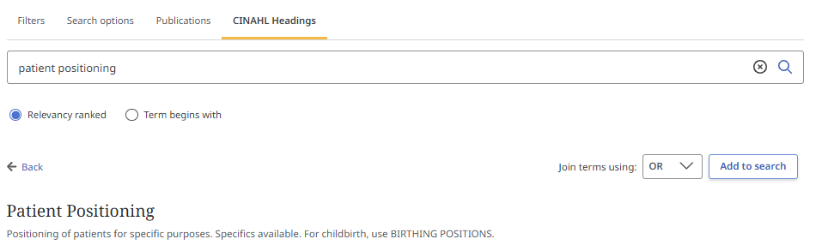
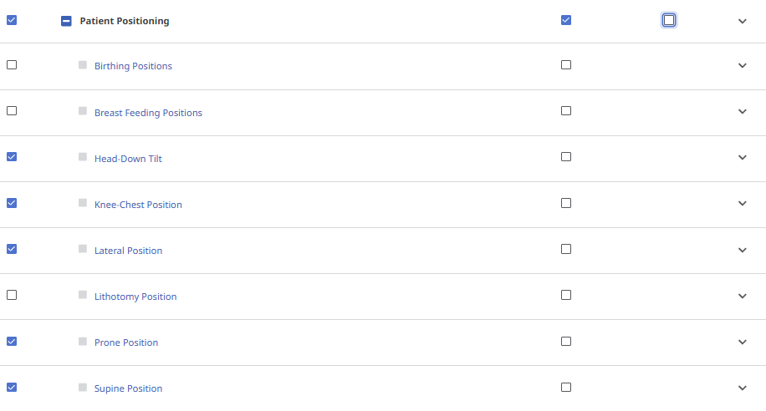
Adding Subject Headings to a search
To add a term from the Subject Headings to a search, simply select the checkbox next to the terms and/or subheadings that you want to use.
If you wish to search for a term and all narrower terms, select the “Explode” option.
Selecting “Major Concept” will narrow to results in which your term is a major focus of the article.
Choose the desired Boolean operator from the dropdown, then click “Add to Search.”
This will automatically format your terms with all necessary Field Tags and Boolean operators and add it to the search field. Click on “Search” to run.

Slide 21
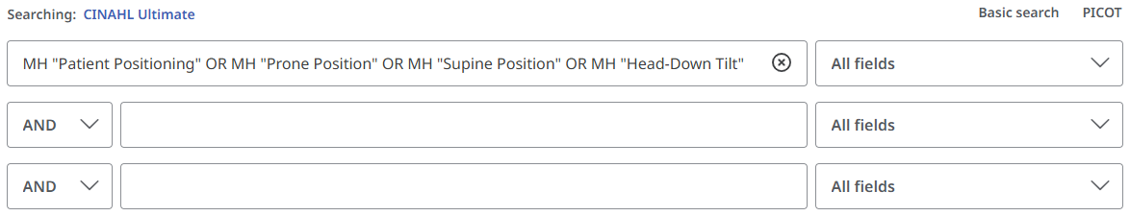
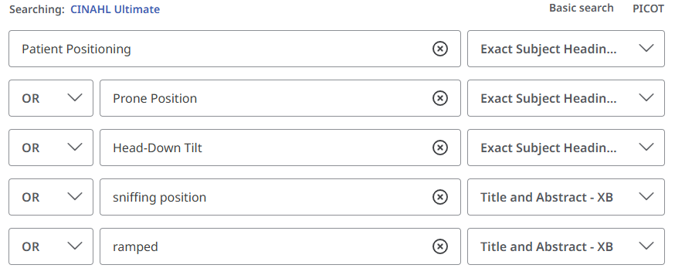
Combining search terms
In addition to using the Search Options to combine terms, you can also use the drop downs to add operators and field tags.
You can also manually add operators, field tags, and proximity indicators by simply typing them into the search boxes.

Slide 22
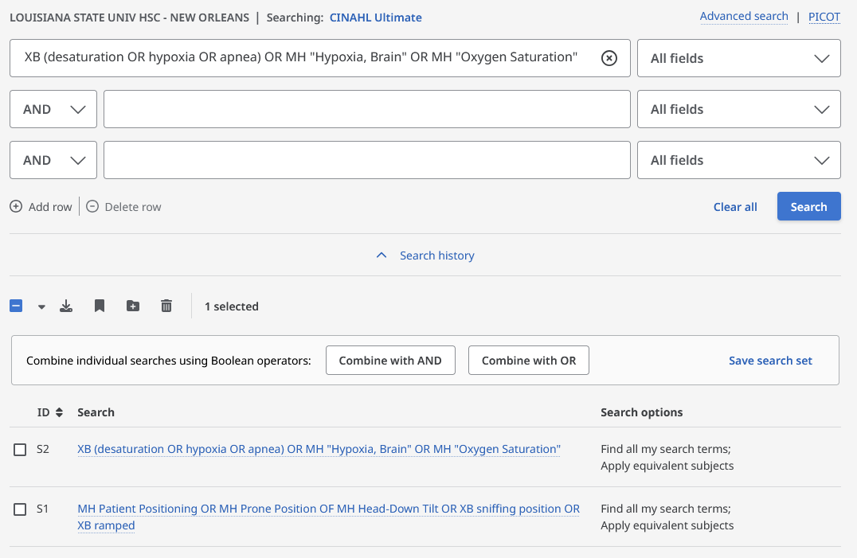
Search History
Search History can be found under the search bars on the results page. Use the up/down arrow to hide or expand your search history.
You can save your search history from a session by selecting “Save search set.” This will give you the option to name the search set and retrieve your queries.

Slide 23
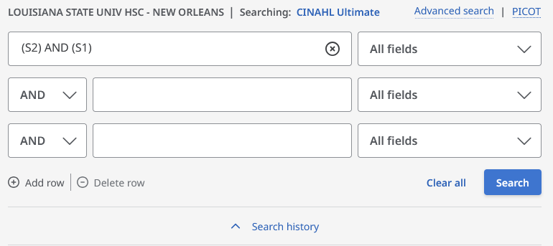
Combining searches
You can combine searches from your history. Just select the box next to the relevant searches from your history, then choose either “Combine with AND” or “Combine with OR” at the top of your history list.
This will add the select searches to the search field. Just click Search to run the combined search.
TIP: make sure to clear any old searches from your search bar before combining searches.

Slide 24
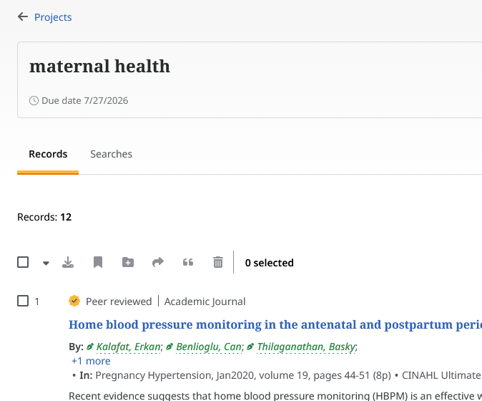
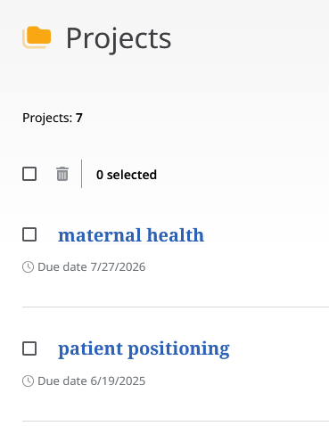
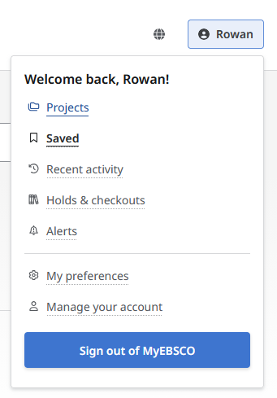
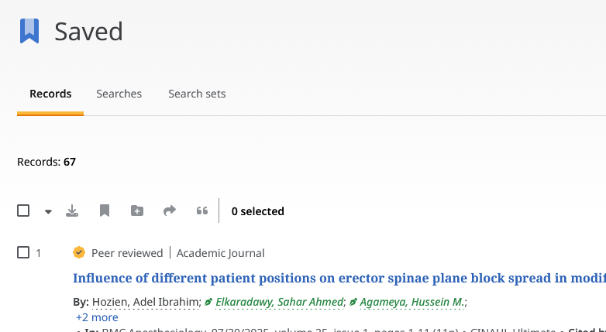
Dealing with Results
EBSCO offers two ways to save searches and records in its databases.
Projects
Allows the user to create “Projects.” Under these you can save both Records and Searches. These projects can be named and given both brief descriptions and due dates.
Saved
Similar to Projects, this feature allows you to save Records, Searches, and Search Sets. Unlike Projects, saving does not include organizational tools. All saved records appear in the same list.

Slide 25
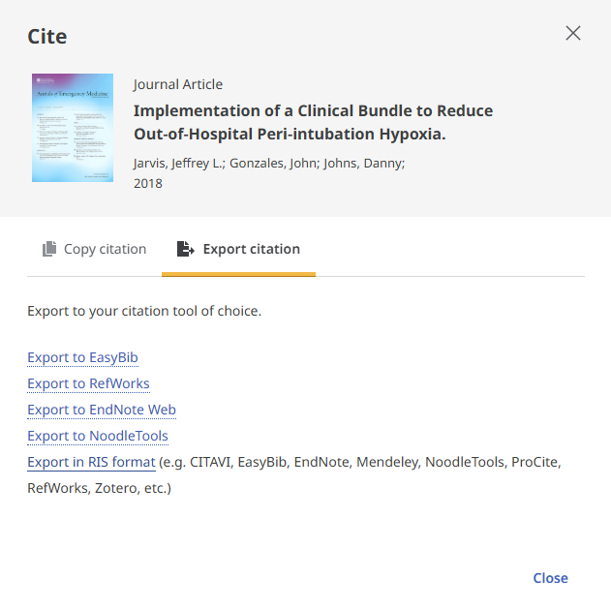
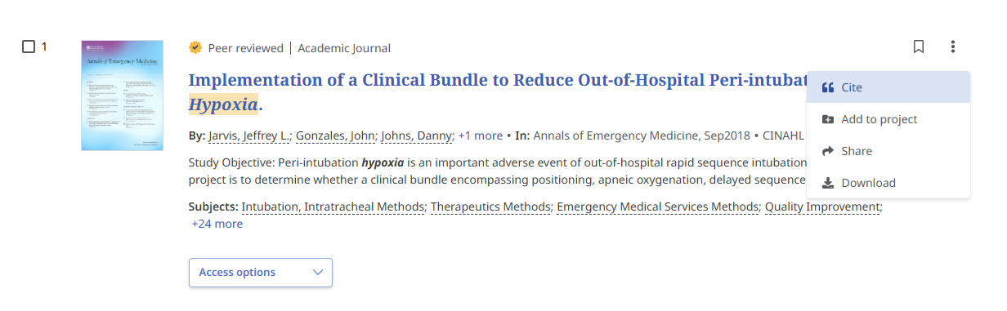
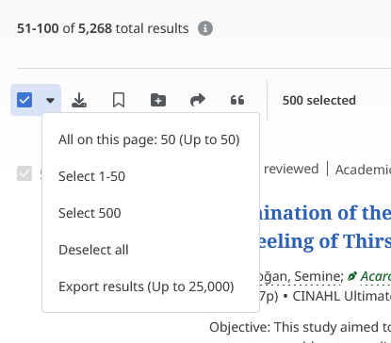
Exporting Results to a Citation Manager
Individual citations can be exported by selecting “Cite” from the menu either in the search results or the article record.
To export bulk citations either select the checkboxes next to the relevant articles, or use the dropdown at the top of the results to bulk-select up to 500 results.
NOTE: if you are not logged into your MyEBSCO account, you will only be able to export a page of citations (50) this way.
Selected citations can be either copied as text in a variety of citation styles or exported.
CINAHL provides options to export directly to a variety of Citation Managers, or to download an RIS file.

Slide 26
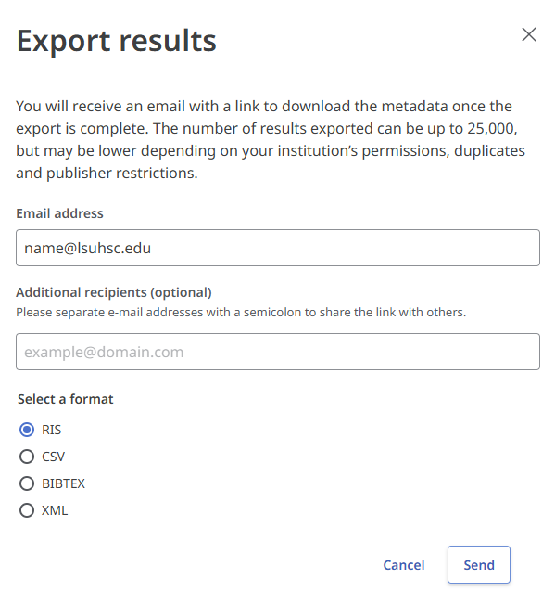
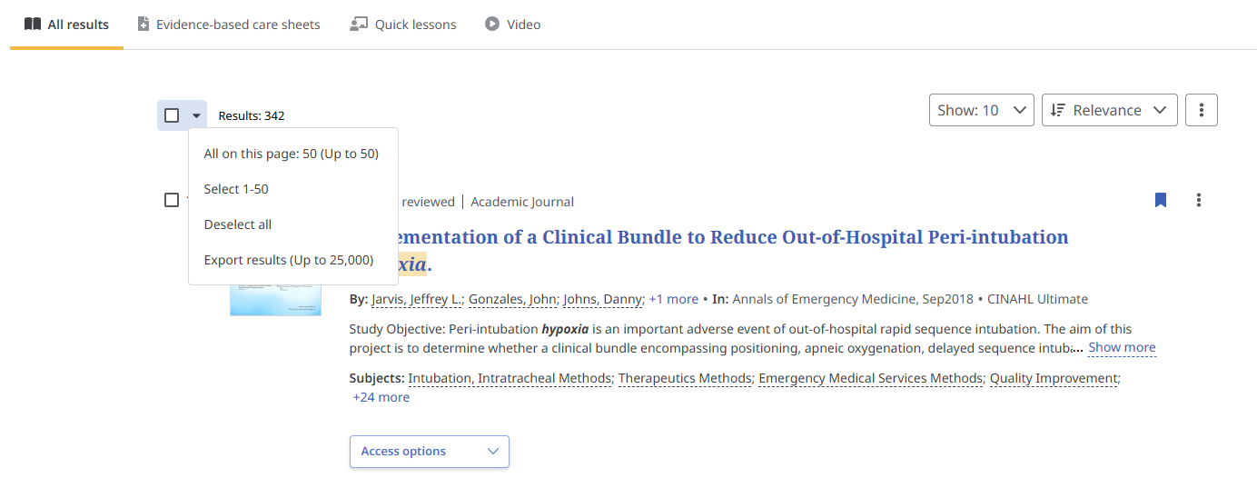
Exporting a full result set
To export a larger batch of citations or a complete set of search results, click on the down arrow next to the “Select All” box at the top of the result list.
On the next screen, enter your email address and select your desired format to have a download link mailed to you.

Slide 27

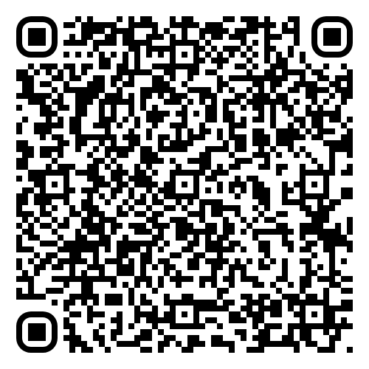

Thank you!
We are here to help!
Contact the Library:
reference@lsuhsc.edu
504-568-6100
Library Website: www.lsuhsc.edu/library/
Survey (Very short!)
Help us collect metrics!
Sign up for Library Emails!
Follow us on Instagram!
Sharon Duffy
Research Services Librarian
sduffy@lsuhsc.edu
Rowan Marye
Public Services Librarian
rmarye@lsuhsc.edu

