Slide 1
Research Poster Design
Creating an appealing and accessible poster

Slide 2
First Steps
Check size requirements before starting. Starting with the right proportions eliminates unnecessary work later.
Is there an existing template?
Use the right software:
  Includes tools for enhancing accessibility
  Allows range of size options and resizing functionality
Locate high-quality version of all images, charts, and graphs.

Slide 3
Why not Canva?
Lacks accessibility tools such as reading order.
Fonts and graphics are not necessarily available in other programs, which can cause problems in sharing and exporting.
Crucial functionality, i.e. adjusting poster size, is only available on paid accounts.

Slide 4
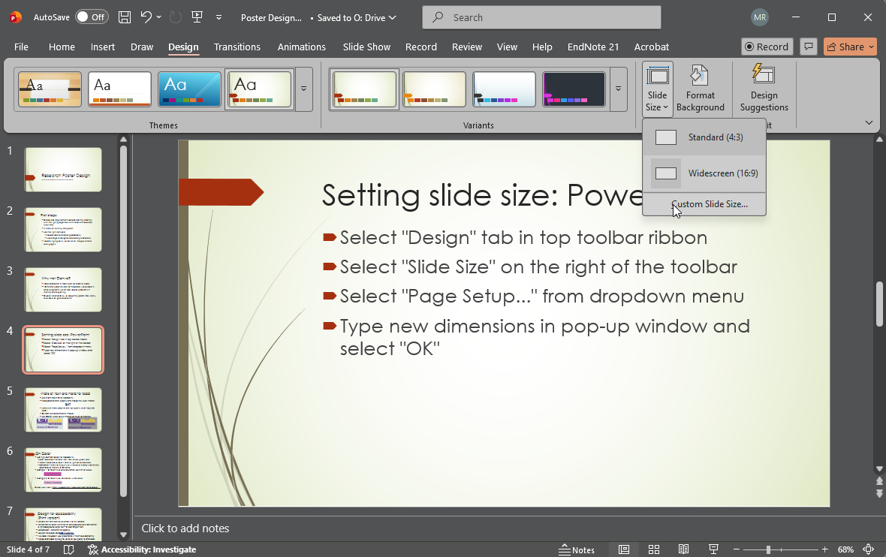
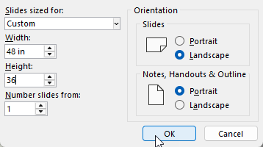
Setting slide size: PowerPoint
Select "Design" tab in top toolbar ribbon
Select "Slide Size" on the right of the toolbar
Select "Page Setup..." from dropdown menu
Type new dimensions in pop-up window and select "OK“
Maximum size is 56 inches.

Slide 5
Adobe Express
LSUHSC has seats available to students for Adobe Express. Contact your schools IT supporters for access.
Access in browser at: https://new.express.adobe.com/
Maximum size is 48 inches.
Includes handy tools like QR code generator.
Easy to export posters as PDFs.

Slide 6
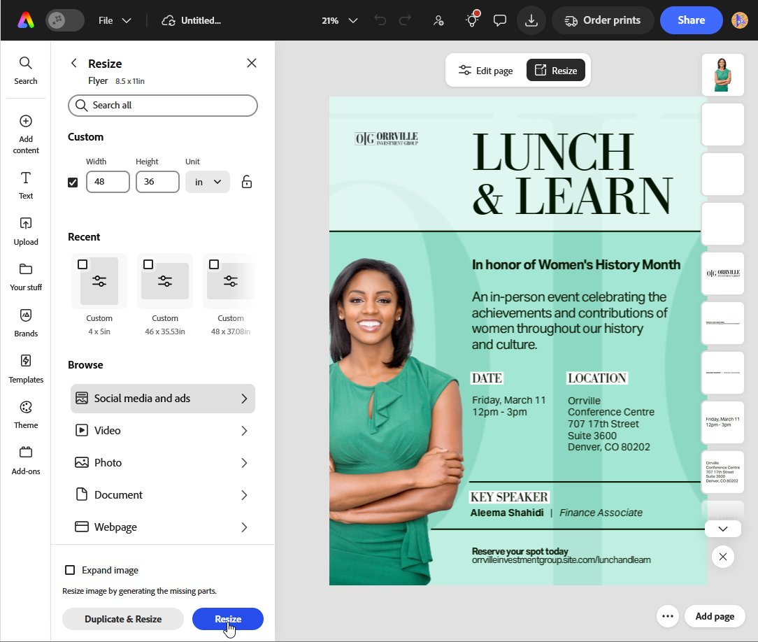
Setting poster size: Adobe Express
Create a blank document or open an existing template.
Click on “Resize” above the document.
In the side panel, enter the desired dimensions OR choose from recent sizes or their list of templates.

Slide 7


Text and Graphics
Use a font size of 20 for readability.
Incorporate charts, graphs, and images for visual interest and to break up large blocks of text.
BUT
Make sure these graphics are high quality, even required logos.
Do NOT use screenshots of images.
Use 300 dpi when saving images as much as possible.

Slide 8


On Color
Use high contrast colors for readability.
  Hue – describes the color itself: red, yellow, green, etc.
  Value – describes a color’s relative lightness or darkness.
  Saturation – refers to the purity or vividness of a color (sometimes described as Intensity or Chroma)
Example 1: different hue and saturation, but similar value.
Example 2: different hue, saturation, AND value.
Check your work: https://webaim.org/resources/contrastchecker/

Slide 9
Design for accessibility
(Print version)
Use sans serif fonts such as Helvetica, Arial, or Verdana.
Use contrasting colors (white text on dark background or dark text on a light background)Larger text – at least 20-point font.
Use between 1.2 and 2.0 line spacing.
Use plain language. See CDC's guidelines.
If a video is included in your presentation, it must have captioning.
Include a QR code for a digital version of your poster for attendees who are blind/low vision. QR codes should be at least 5”x5”.
  Materials shared in a QR code should be screen reader accessible.
Do not place text over images.
From APHA’s 2026 Annual Meeting guidance: https://www.apha.org/events-and-meetings/annual/presenters/accessibility-guidelines

Slide 10
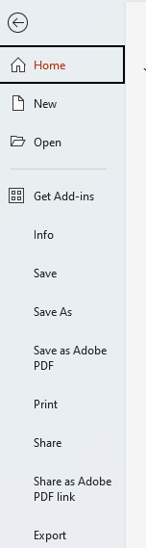
Convert your PowerPoint to PDF
Depending on which version of PowerPoint you are using, you may see slightly different options.
Navigate to File -> or Save As
Give your poster an appropriate name
Ensure PDF is selected file Format
DO NOT select “Print to PDF,” which will resize your poster to 8.5”x11”.
If you see the option “Save as Adobe PDF,” This will also work. It will save the file as .ppt first, then export it to Adobe where you can review it and save from there.

Slide 11
Check your work
Once you have completed your slide and converted it to PDF, open it in Adobe to check your work.
Go to Menu, then select “Document Properties” and confirm that the Page Size is correct.
Use the Zoom function to increase the size to 100% to get an idea of how your images will reproduce.
Check for content/spelling/grammar errors
Check the alignment of columns and boxes. Make sure that there are no problem overlaps hiding text or data.

Slide 12
Getting your poster printed
Visit this page for complete policy info: Library Poster Printing Page
Complete the form linked on the page.
Wait for an email from us confirming receipt and that your proof is ready for review.
Come to the Isché Library in person to review and approve your proof.
Revise if necessary – we can only print one copy, so make sure that everything is correct.
We will email you when the poster is ready for pickup.

Slide 13
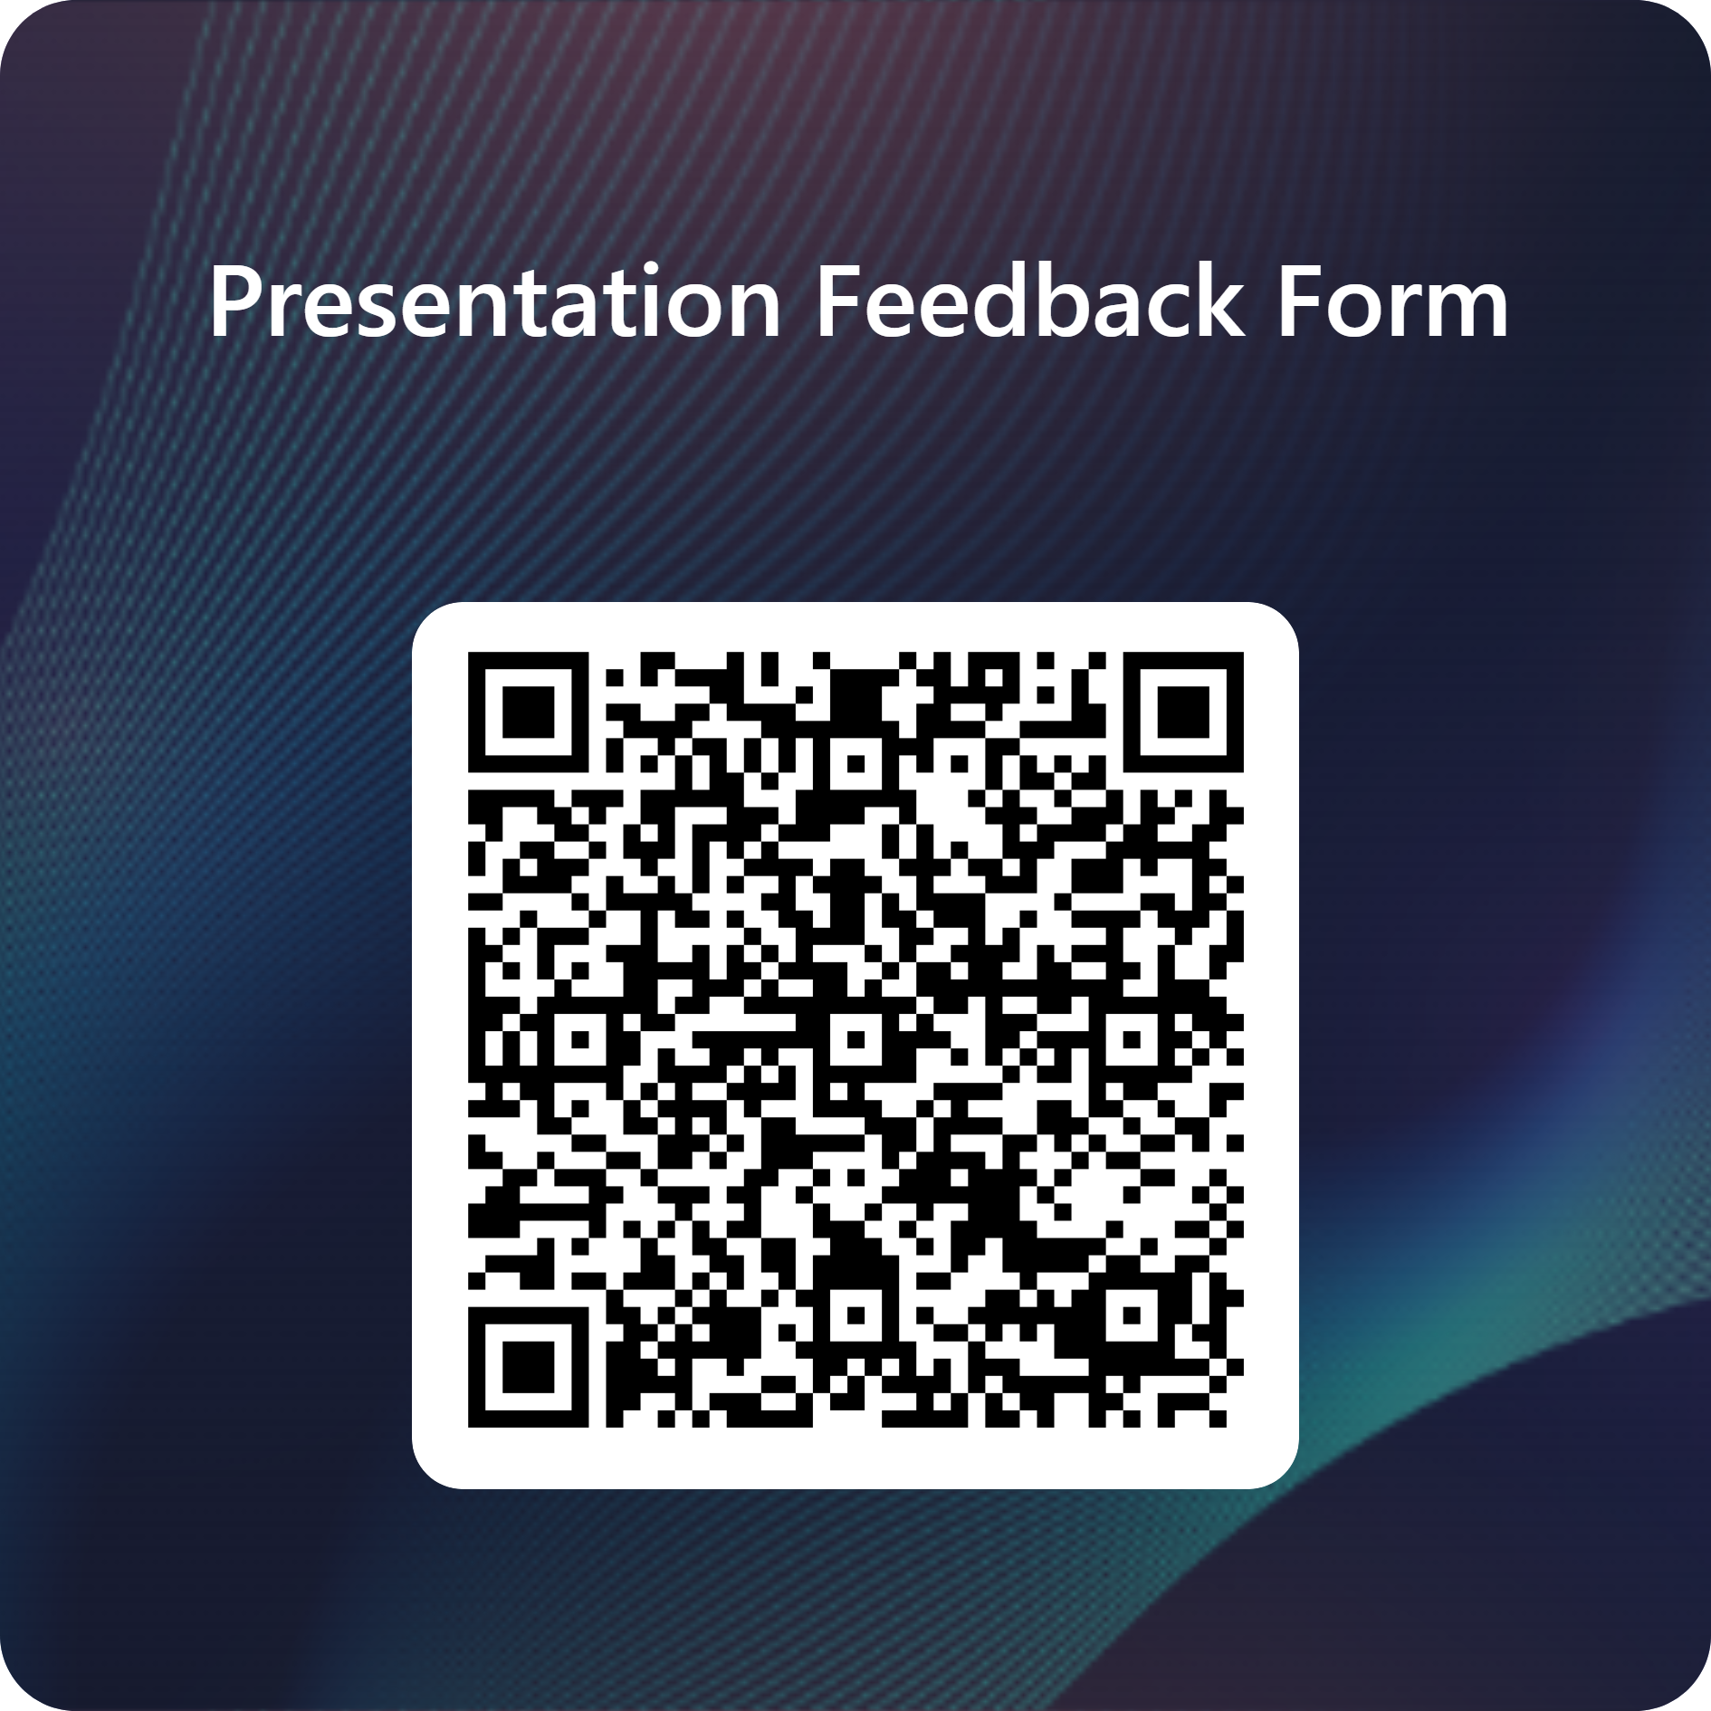
THANK YOU!
For printing questions:
Rowan Marye
rmarye@lsuhsc.edu
For Accessibility questions:
Elizabeth Holt
eholt3@lsuhsc.edu

